Slide 1
Projection
Parallel And Perspective Projection

Slide 2
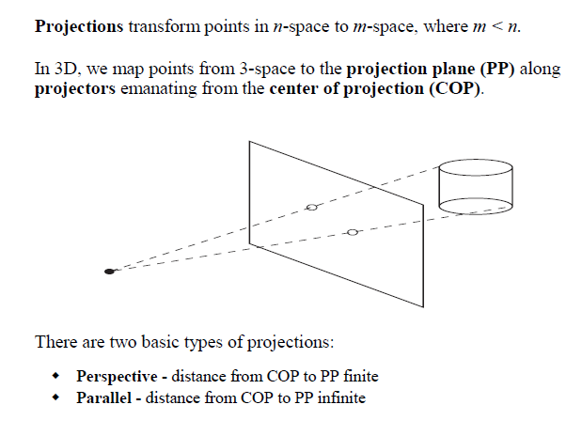
Projections

Slide 3
A parallel projection
A parallel projection is a projection of an object in three-dimensional space onto a fixed plane referred as the projection plane or image plane, where the rays, known as lines of sight or projection lines are parallel to each other. The projection is referred to as orthographic if the rays are perpendicular to the image plane and oblique or skew if they are not.

Slide 4
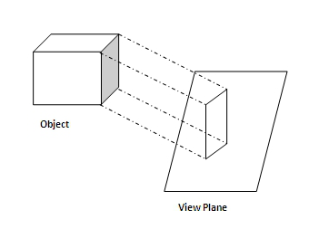
Parallel projections are popular in technical applications because its very simple to implement and are used to create quick and informal pictorials of objects.

Slide 5
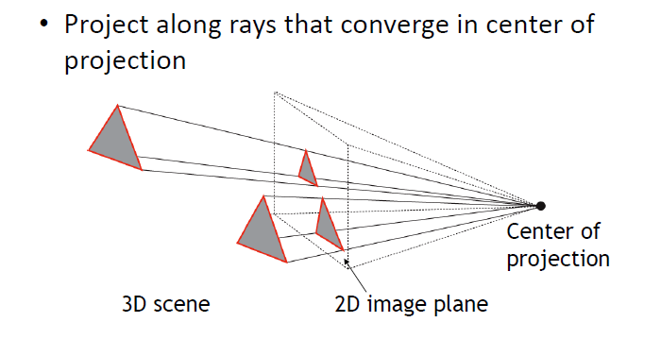
A perspective projection

Slide 6
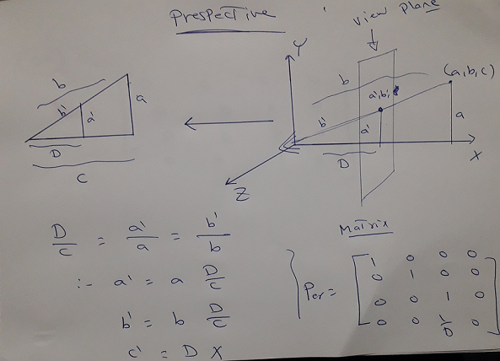
perspective projection

Slide 7
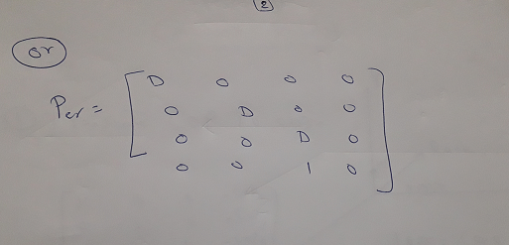
perspective projection

Slide 8
Difference Between Perspective & Parallel Projection
Perspective projection is representing or drawing objects which resemble the real thing
perspective projection represents objects in a three-dimensional way.
In perspective projection, objects that are far away appear smaller, and objects that are near appear bigger

Slide 9
Difference Between Perspective & Parallel Projection
4. While parallel projection may be best for architectural drawings, in cases wherein measurements are necessary.
5. perspective projections require a distance between the viewer and the target point.
6. In parallel projection the center of projection is at infinity, while in prespective projection, the center of projection is at a point

Slide 10
Difference Between Perspective & Parallel Projection
7. it is better to use perspective projection
8. parallel projection does not create effect.
9. Parallel projection is much like seeing objects through a telescope, letting parallel light rays into the eyes which produce visual representations without depth.

